Slide 1
20CS19-BIG DATA ANALYTICS

Slide 2
Course Outcomes:
CO1: Identify Big Data and its Business Implications. (Understand - L2)
CO2: Process of distributed file system using Hadoop(Apply - L3)
CO3: Illustrate the MapReduce mechanism (Apply - L3)
CO4: Develop structured data processing tools (Apply- L3)
CO5: Develop semi/unstructured data processing tools (Apply L3)

Slide 3
Syllabus
UNIT I: Introduction to Big data
UNIT II: Hadoop Distributed File System
UNIT III: MapReduce Technique
UNIT IV: Structured Data Processing Tools
UNIT V: Semi-structured and unstructured Data Processing Tools

Slide 4
TEXT BOOKS:
Tom White "Hadoop: The Definitive Guide" Third Edit, O'reily Media, 2012.
2. Big Data and Analytics, 2ed Seema Acharya, Subhashini Chellappan, Wiley 2015.

Slide 5
UNIT I: Introduction to Big data
Types of Digital Data, Classification of Digital Data, Characteristics of Data, Evolution of Big Data, Definition of Big Data, Challenges with Big Data, What is Big Data?, Other Characteristics of Data Which are not Definitional Traits of Big Data, Why Big Data?, analyzing Data with Unix tools, Analyzing Data with Hadoop, Hadoop Streaming, Hadoop Echo System.

Slide 6
UNIT II: Hadoop Distributed File System The Design of HDFS, HDFS Concepts, Command Line Interface, Hadoop file system interfaces, Data flow, Data Ingestion with Sqoop and Hadoop archives, Hadoop I/O: Compression, Serialization, Avro and File-Based Data structures.

Slide 7
UNIT III: MapReduce Technique How MapReduce works?, Anatomy of a Map Reduce Job Run, Failures, Job Scheduling, Shuffle and Sort, Task Execution, Map Reduce Types and Formats, Map Reduce Features.

Slide 8
UNIT IV: Structured Data Processing Tools Hive: Installation, Running Hive, HiveQL, Tables, Querying Data, User Defined functions Sqoop: Introduction, generate code, Database import, working with imported data, Importing large objects, performing an exports.

Slide 9
UNIT V: Semi-structured and unstructured Data Processing Tools
Pig: Introduction to PIG, Execution Modes of Pig, Comparison of Pig with Databases, Grunt,Pig Latin, User Defined Functions, Data Processing operators.
HBase: Basics, Concepts, Clients, Example, HBase Versus RDBMS.

Slide 10
Big data
Big data refers to data that is so large, fast or complex that it's difficult or impossible to process using traditional methods. The act of accessing and storing large amounts of information for analytics has been around for a long time.

Slide 11

Data- What Makes it Big???
How big is big?
No Single Definition
The term ‘big data’ is self-explanatory − a collection of huge data sets that normal computing techniques cannot process.
“Big Data” is data whose scale, diversity, and complexity require new architecture, techniques, algorithms, and analytics to manage it and extract value and hidden knowledge from it…

Slide 12
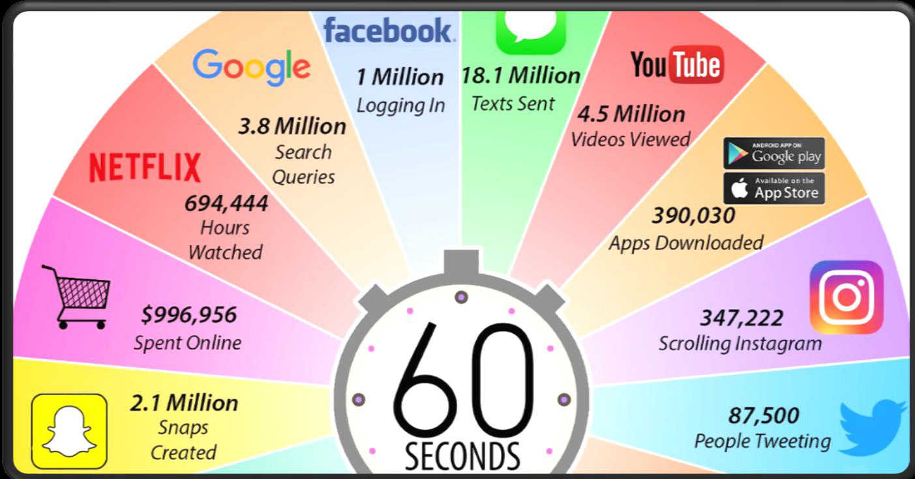

Slide 13

Big Facts About Big Data
As of 2013, experts believed that 90% of the world’s data was generated from 2011 to 2012.
In 2018, more than 2.5 quintillion bytes of data were created every day.
The amount of data in the world was estimated to be 44 zettabytes at the dawn of 2020.
Google handles a staggering 1.2 trillion searches every year.

Slide 14

Of Bits and Bytes…….
A gigabyte is equal to 1,024 megabytes. A terabyte is equal to 1,024 gigabytes.
A petabyte is equal to 1,024 terabytes.
An exabyte is equal to 1,024 petabytes. A zettabyte is equal to 1,024 exabytes. A yottabyte is equal to 1,024 zettabytes.
10²¹ bytes equal to 1 zettabyte or one billion terabytes forms a zettabyte.
Looking at these figures one can easily understand why the name Big Data is given and imagine the challenges involved in its storage and processing.

Slide 15
According to Gartner, the definition of Big Data –
“Big data” is high-volume, velocity, and variety information assets that demand cost-effective, innovative forms of information processing for enhanced insight and decision making.”

Slide 16
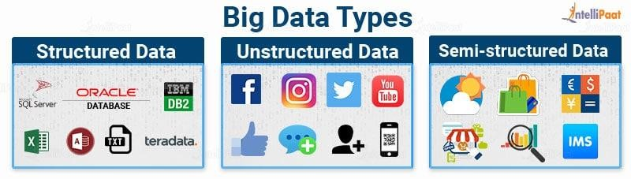
Types of Digital Data
Classification of Digital Data
Big data also encompasses a wide variety of data types, including the following:
Structured data, such as transactions and financial records
Unstructured data, such as text, documents and multimedia files.
Semi structured data, such as web server logs and streaming data from sensors.

Slide 17
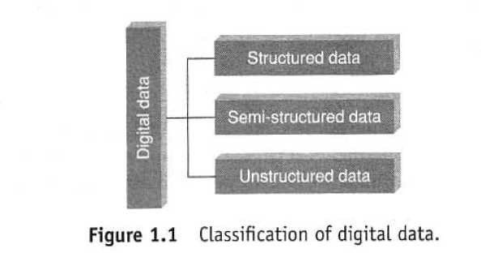
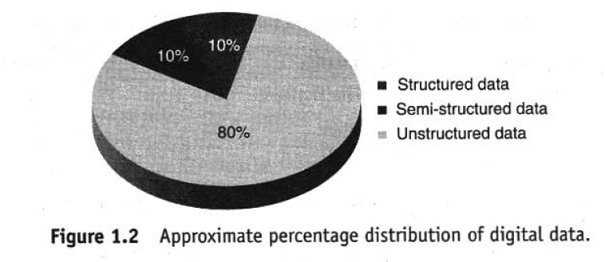

Slide 18
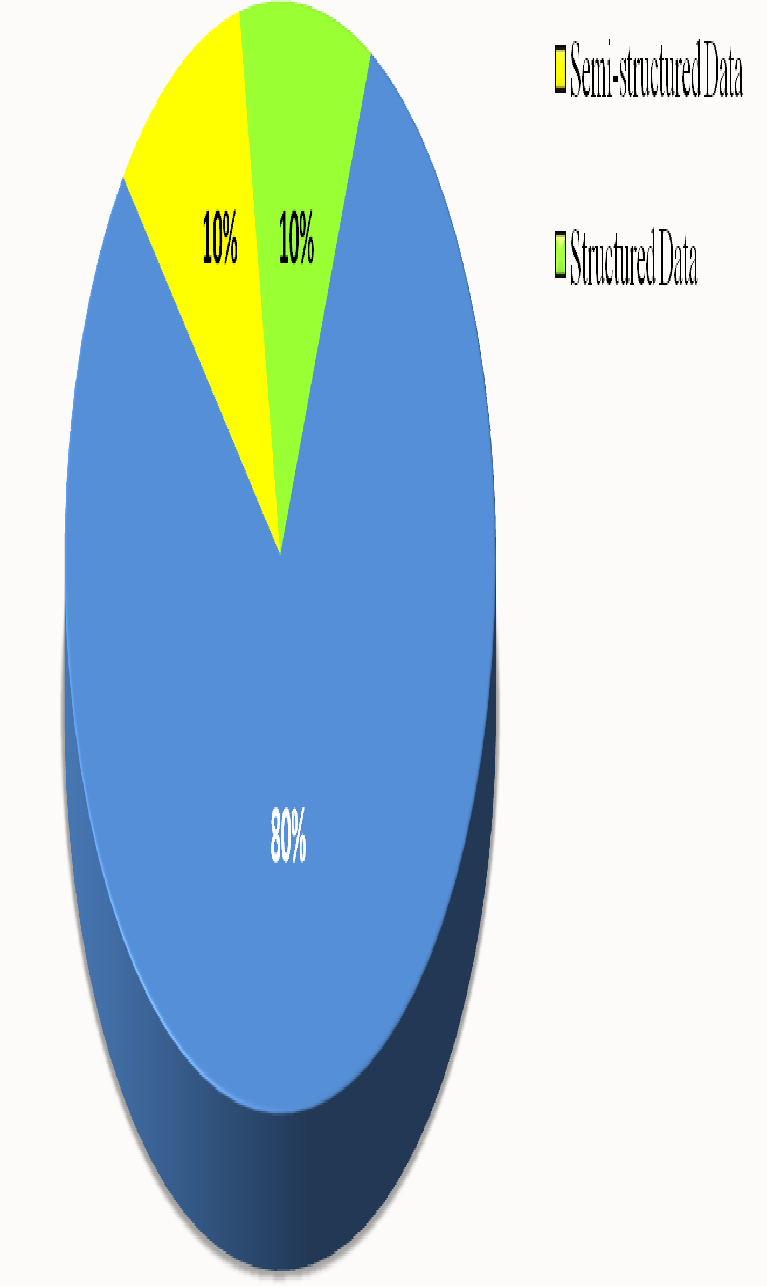
Here is a percent distribution of the three forms of data -

Slide 19
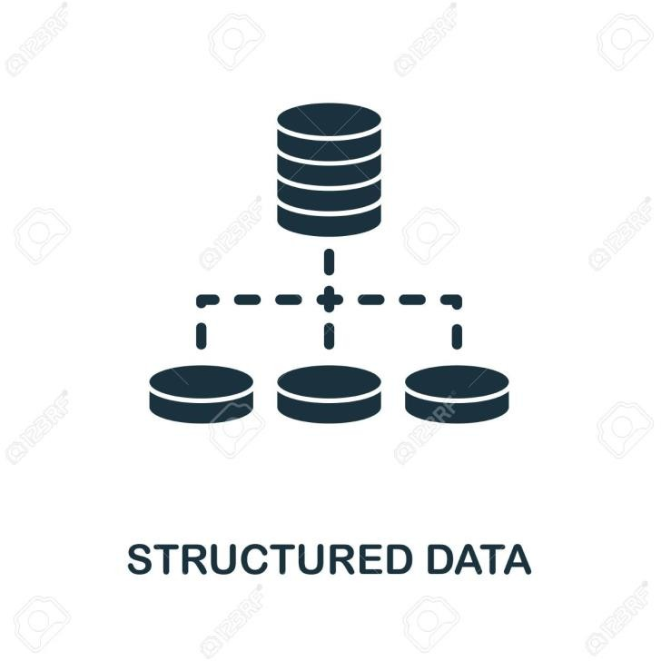
Structured
Any data that can be stored, accessed and processed in the form of fixed format is termed as a 'structured' data.
The format is well known in advance. Can derive value out of it.
Currently typical sizes are being in the rage of multiple zettabytes.

Slide 20
Structured Data
Employee_I D | Employee_ Name | Gender | Department | Salary_In_la cs
2365 | Rajesh Kulkarni | Male | Finance | 650000
3398 | Pratibha Joshi | Female | Admin | 650000
7465 | Shushil Roy | Male | Admin | 500000
7500 | Shubhojit Das | Male | Finance | 500000
7699 | Priya Sane | Female | Finance | 550000

Slide 21
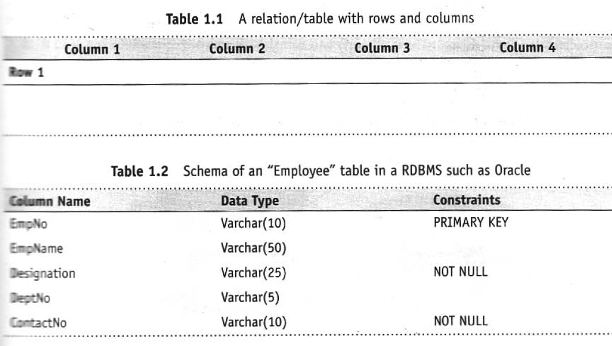
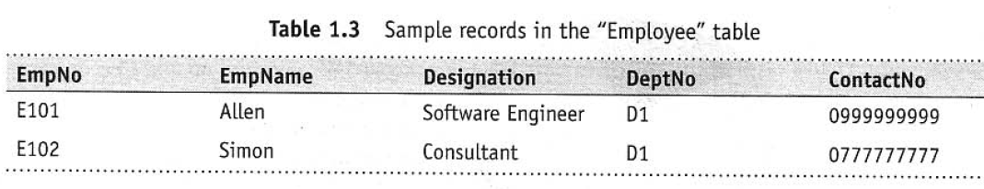
Structured data

Slide 22
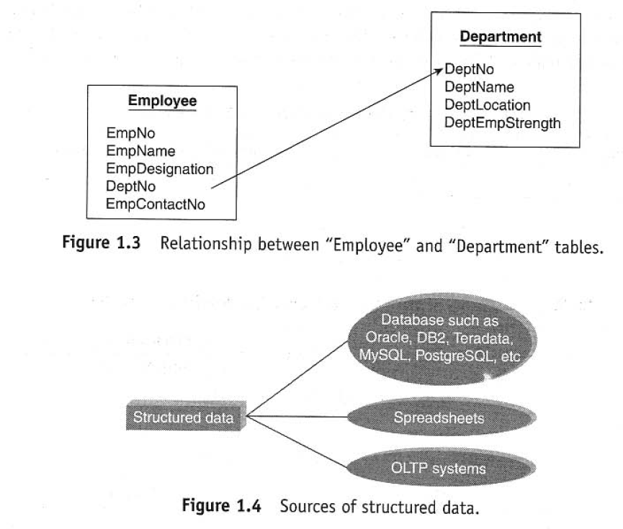
Sources of Structured Data

Slide 23
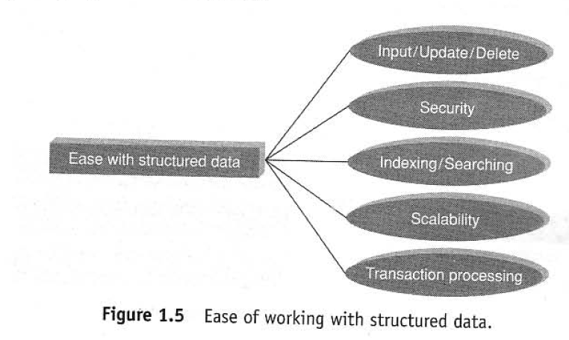
Ease of Working with structured Data

Slide 24
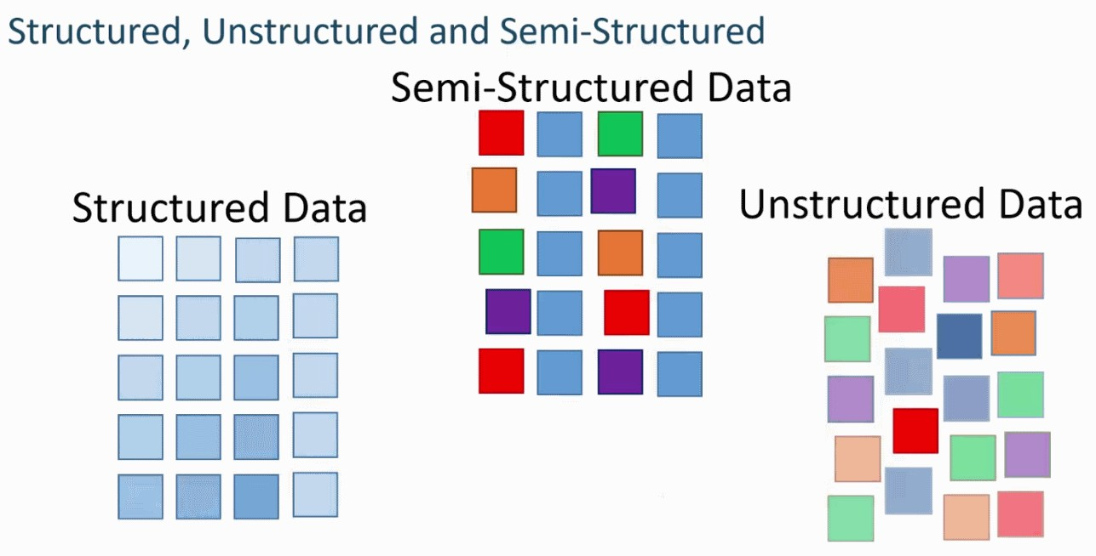
Semi-structured
Semi-structured data can contain both the forms of data. We can see semi-structured data as a structured in form but it is actually not defined like a table definition in relational DBMS.
Example of semi-structured data is a data represented in an XML file.

Slide 25
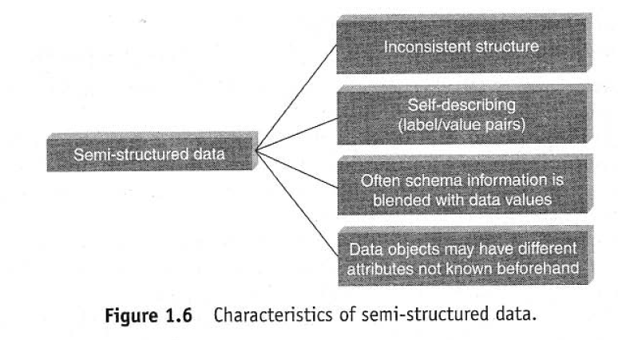
Semi Structured Data

Slide 26
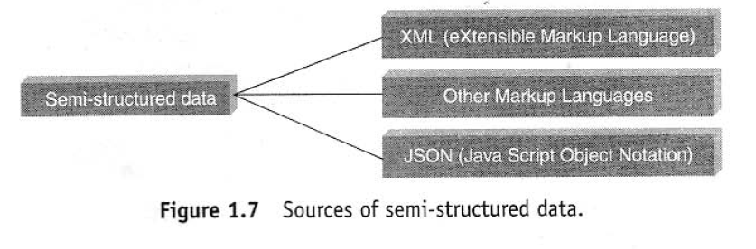
Source of Semi Structured Data

Slide 27




Where does Semi-structured Data Come from?
E-mail
XML
TCP/IP packets
Zipped files
Semi-structured data
Binary executables
Mark-up languages
Integration of data from heterogeneous sources

Slide 28
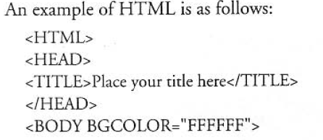
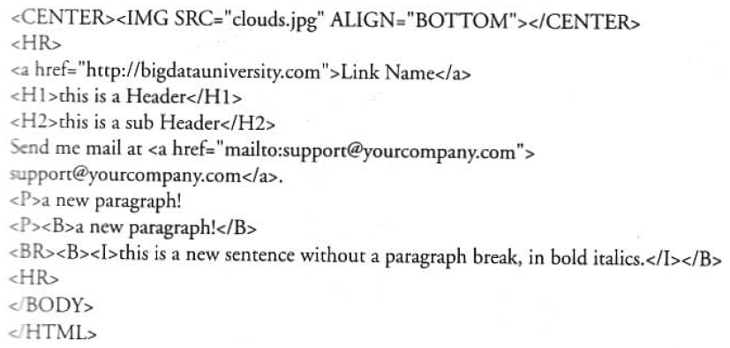

Slide 29
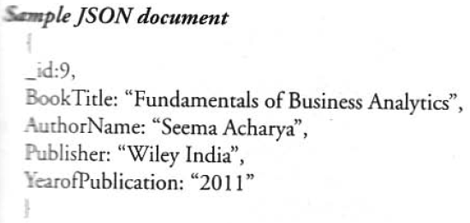

Slide 30
Semi Structured
<rec><name>Prashant Rao</name><sex>Male</sex><age>35</age></rec>
<rec><name>Seema R.</name><sex>Female</sex><age>41</age></rec>
<rec><name>Satish Mane</name><sex>Male</sex><age>29</age></rec>
<rec><name>Subrato Roy</name><sex>Male</sex><age>26</age></rec>
<rec><name>Jeremiah J.</name><sex>Male</sex><age>35</age></rec>

Slide 31

What is Semi-structured Data?
Does not conform to a data model but contains tags & elements (metadata)
Cannot be stored in form of rows and columns as in a database
Similar entities are grouped
Semi- structured data
Attributes in a group may not be the same
The tags and elements describe how data is stored
Not sufficient Metadata

Slide 32


How to Store Semi-structured Data?
Storage cost
Storing data with their schemas increases cost
RDBMS
Semi-structured data cannot be stored in existing RDBMS as data cannot be mapped into tables directly
Irregular and partial structure
Some data elements may have extra information while others none at all
Challenges faced
In many cases the structure is implicit.
Implicit structure
Interpreting relationships and
correlations is very difficult
Evolving schemas
Schemas keep changing with requirements making it difficult to capture it in a database
Distinction between schema and data
Vague distinction between schema and data exists at times making it difficult to capture data

Slide 33
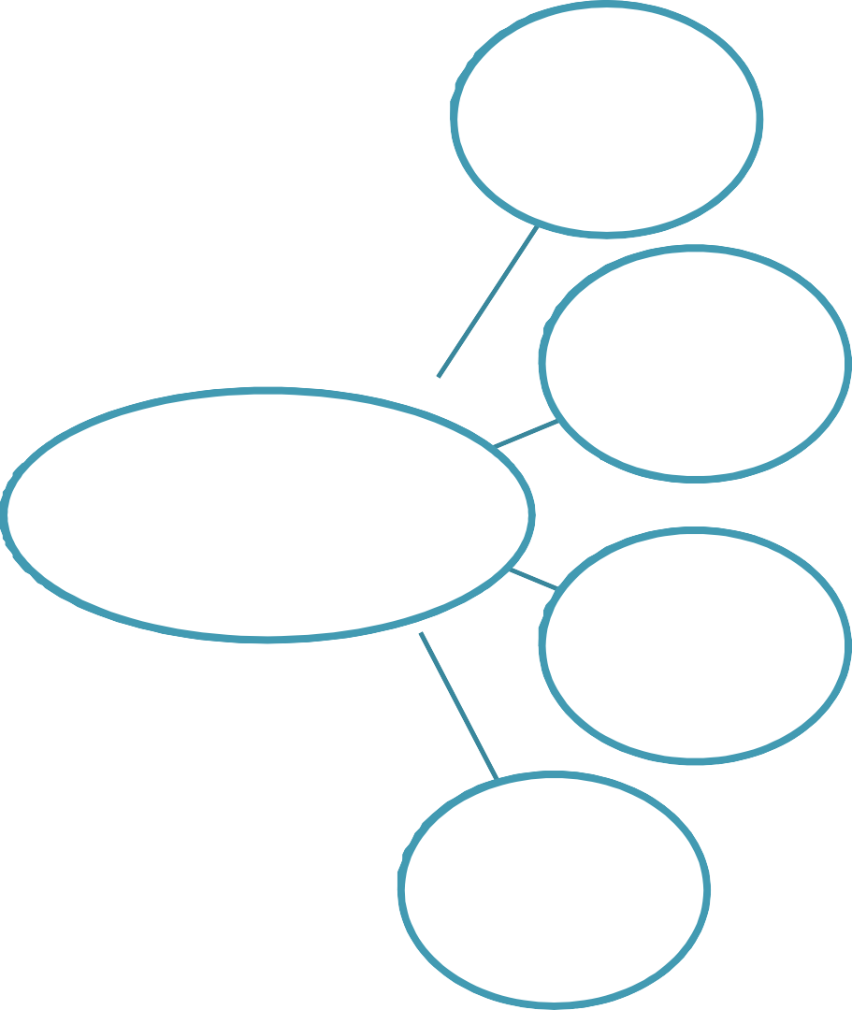
How to Store Semi-structured Data?
XML allows to define tags and attributes to store data. Data can be stored in a hierarchical/nested structure
XML
Semi-structured data can be stored in a relational database by mapping the data to a relational schema which is then mapped to a table
RDBMS
Possible solutions
Special purpose DBMS
Databases which are specifically designed to store semi-structured data
OEM
Data can be stored and exchanged in the form of graph where entities are represented as objects which are the vertices in a graph

Slide 34



How to Extract Information from Semi-structured Data?
Indexing data in a graph-based model enables quick search
Indexing
OEM
Allows data to be stored in a graph-based data model which is easier to index and search
Possible solutions
XML
Allows data to be arranged in a hierarchical or tree-like structure which enables indexing and searching
Mining tools
Various mining tools are available which search data based on graphs, schemas, structure, etc.

Slide 35
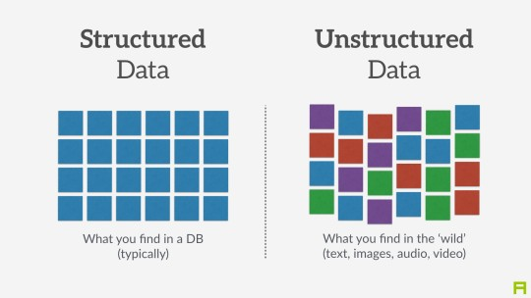
Unstructured Data
Data with unknown form or the structure.
Apart from being huge it poses multiple challenges in terms of its processing for deriving value out of it.
A typical example of unstructured data is a heterogeneous data source containing a combination of simple text files, images, videos etc.
Raw form or unstructured format created complexity.

Slide 36
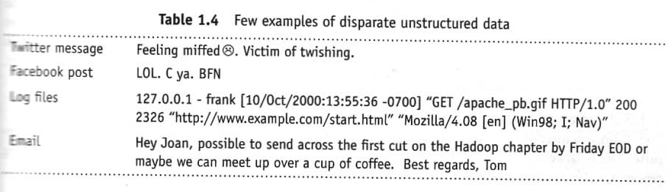
Unstructured Data

Slide 37
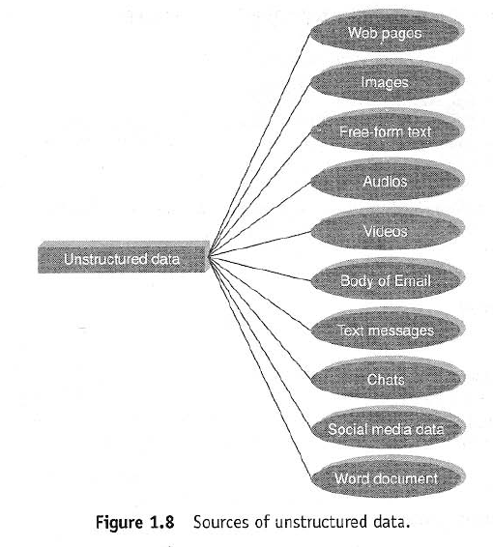

Slide 38
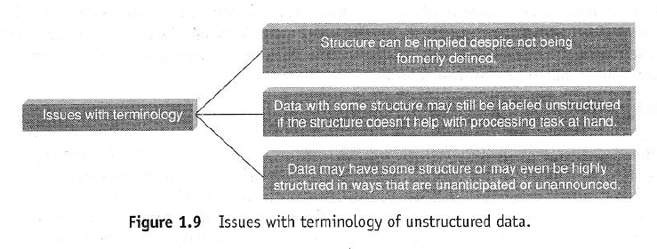
Issues with Unstructured Data

Slide 39
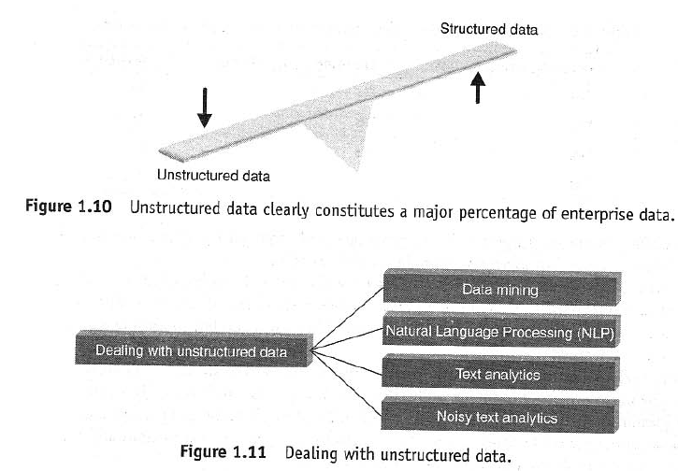
How to Deal with Unstructured Data

Slide 40
The Following techniques are used to find patterns or interpret Unstructured Data
Data Mining
Association rules
Regression Analysis
Collaborative Filtering
Text Analytics or Text Mining
Natural Language Processing
Noisy Text Analysis
Manual tagging with Meta Data
Part of Speech Tagging
Unstructured Information Management Architecture (UIMA)

Slide 41

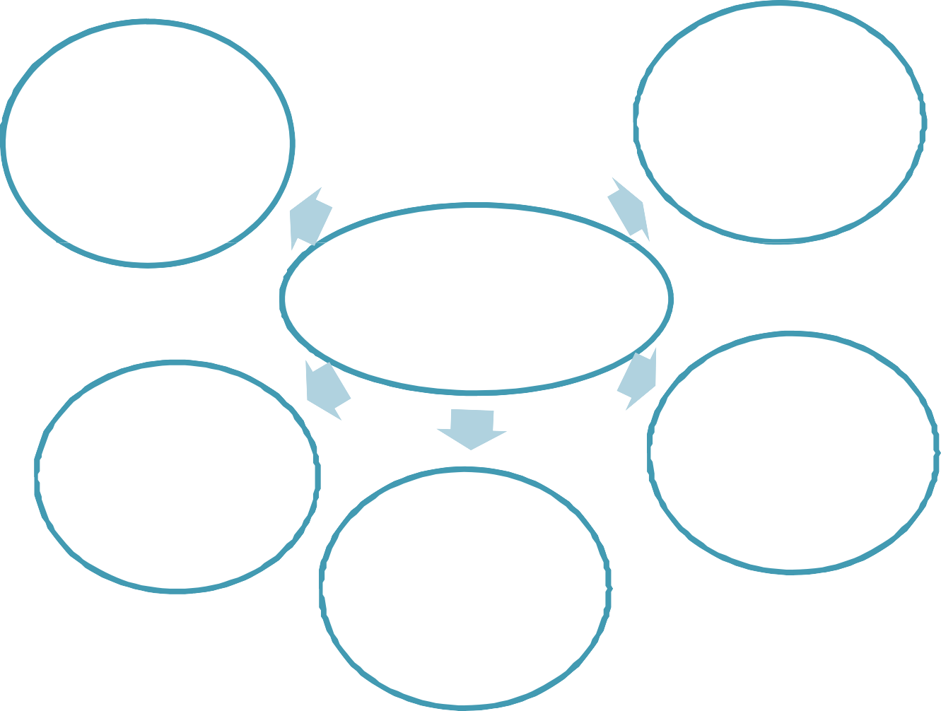
Characteristics of Unstructured Data
Does not conform to any data model
Cannot be stored in form of rows and columns as in a database
Has no easily identifiable structure
Unstructured data
Not in any particular format or sequence
Does not follow any rule or semantics
Not easily usable by a program

Slide 42





Where does Unstructured Data Come from?
Web pages
Memos
Videos (MPEG, etc.)
Images (JPEG, GIF, etc.) Body of an e-mail
Unstructured data
Word document
PowerPoint presentations
Chats
Reports
Whitepapers
Surveys

Slide 43


How to Store Unstructured Data?
Storage Space
Sheer volume of unstructured data and its unprecedented growth makes it difficult to store. Audios, videos, images, etc. acquire huge amount of storage space
Scalability
Scalability becomes an issue with increase in unstructured data
Retrieve information
Retrieving and recovering unstructured data are cumbersome
Challenges faced
Ensuring security is difficult due to varied sources of data (e.g. e-mail, web pages)
Security
Update and delete
Updating, deleting, etc. are not easy due to the unstructured form
Indexing and searching
Indexing becomes difficult with increase in data. Searching is difficult for non-text data

Slide 44

How to Store Unstructured Data?
Change formats
Unstructured data may be be converted to formats which are easily managed, stored and searched. For example, IBM is working on providing a solution which converts audio , video, etc. to text
New hardware
Create hardware which support unstructured data either compliment the existing storage devices or be a stand alone for unstructured data
Possible solutions
RDBMS/ BLOBs
Store in relational databases which support BLOBs which is Binary Large Objects
XML
Store in XML which tries to give some structure to unstructured data by using tags and elements
CAS
Organize files based on their metadata

Slide 45
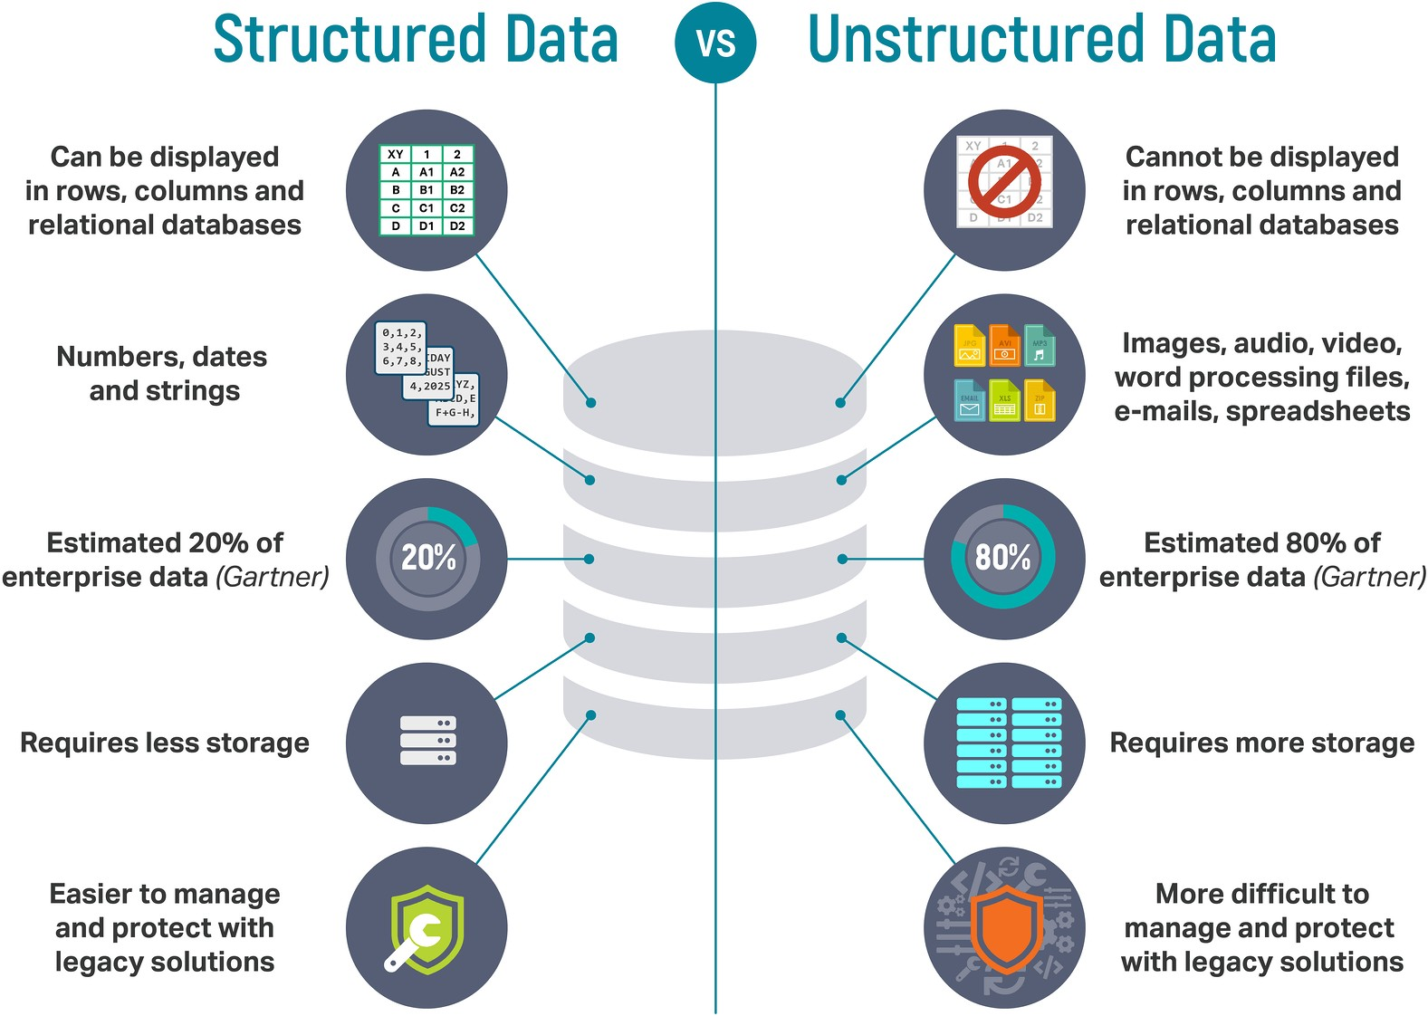

Unstructured Data

Slide 46
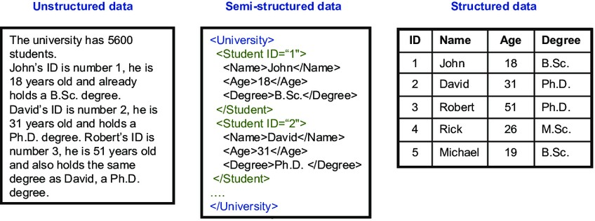
A Contrast of the Three Types

Slide 47
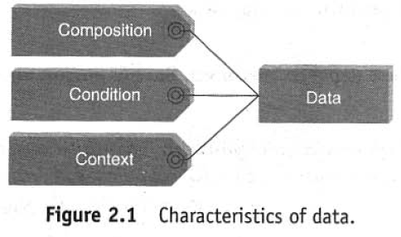
Introduction to Big Data
Characteristics of Data

Slide 48
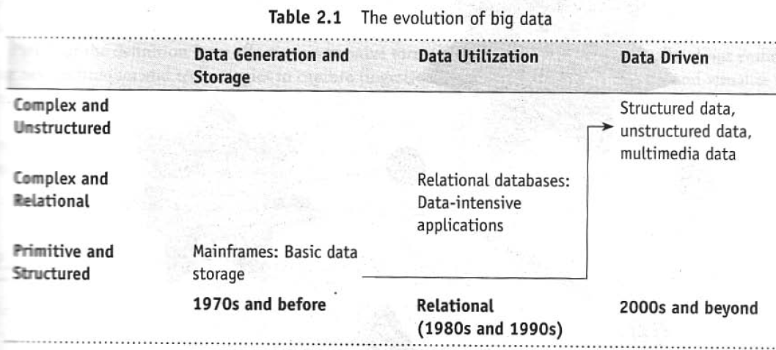
Evolution of Big Data

Slide 49

The Evolution…

Slide 50
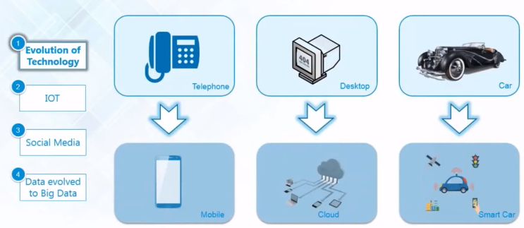
Evolution of Big Data by technology

Slide 51
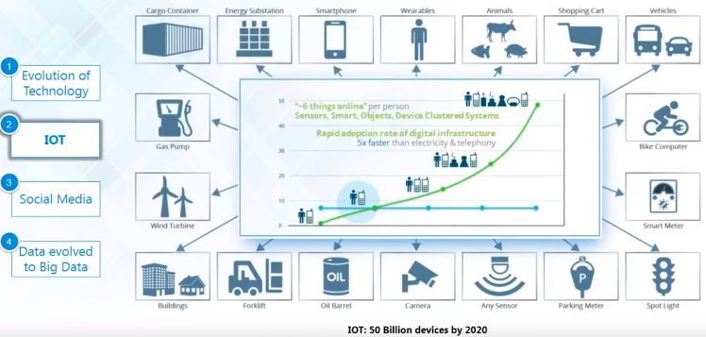
Evolution of Big Data by Internet Of Things

Slide 52
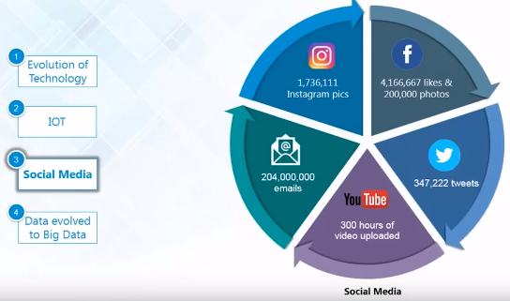
Evolution of Big Data by Social Media

Slide 53
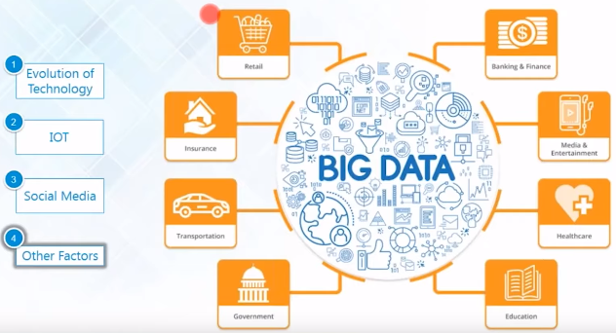
Evolution of Big Data by other factors

Slide 54
Definition of Big Data
Anything beyond the human and technical infrastructure needed to support storage, processing and analysis.
Todays Big may be tomorrow’s NORMAL.
Terabyte or petabyte or Zettabytes of data.
I think its about 3 Vs.

Slide 55
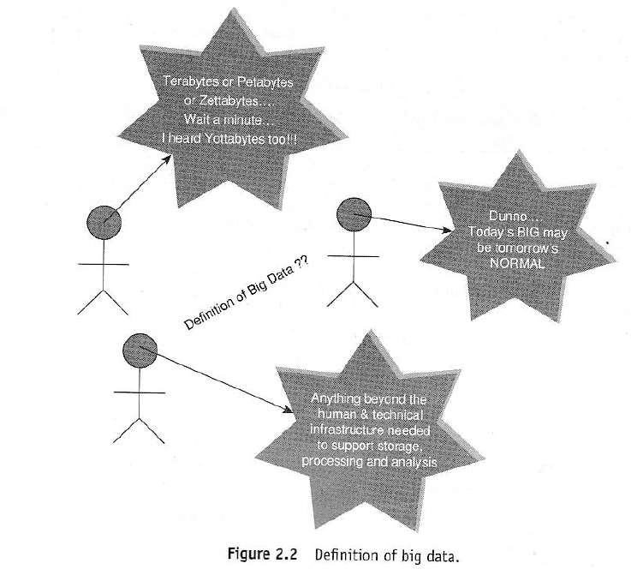

Slide 56
According to Gartner, the definition of Big Data –
“Big data” is high-volume, velocity, and variety information assets that demand cost-effective, innovative forms of information processing for enhanced insight and decision making.”
3 Vs concepts was proposed by Gartner in 2001 Meta group research Publication, titled, 3D Data Management :Collecting Data Volume , verity and Velocity.

Slide 57
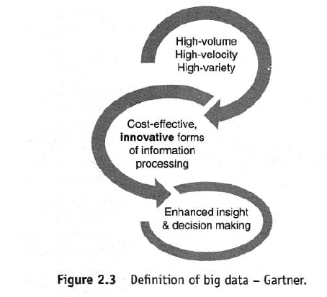

Slide 58
Challenge #1: Insufficient understanding and acceptance of big data
Challenge #2: Confusing variety of big data technologies
Challenge #3: Paying loads of money
Challenge #4: Complexity of managing data quality
Challenge #5: Dangerous big data security holes
Challenge #6: Tricky process of converting big data into valuable insights
Challenge #7: Troubles of up scaling

Slide 59
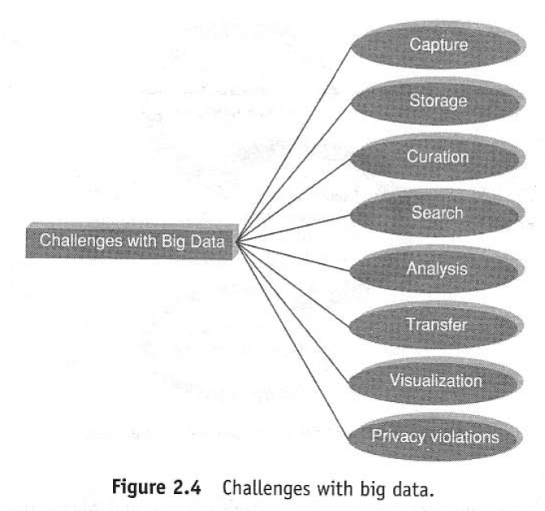

Slide 60
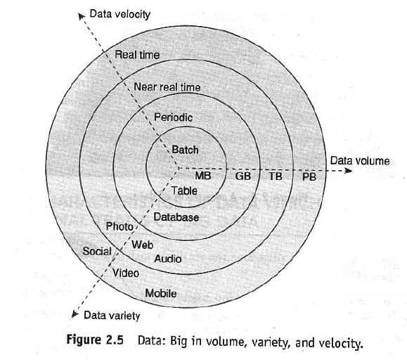
What is Big Data
Big Data is Data that is big in Volume , Velocity and Varity.

Slide 61
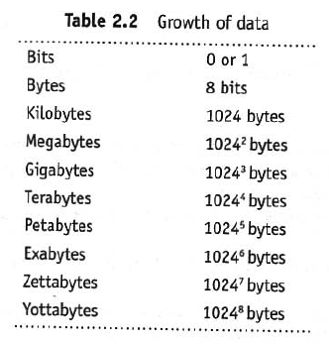
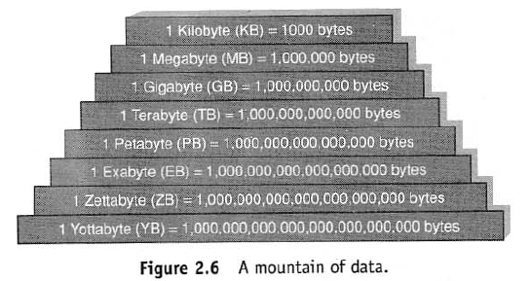
Volume

Slide 62
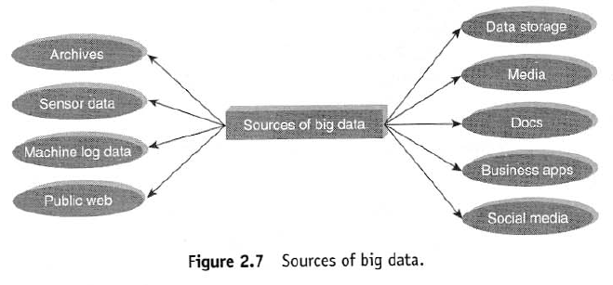
Where does this data Generated ?

Slide 63
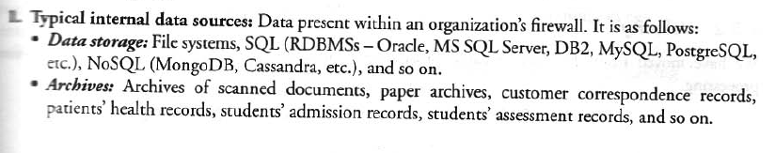
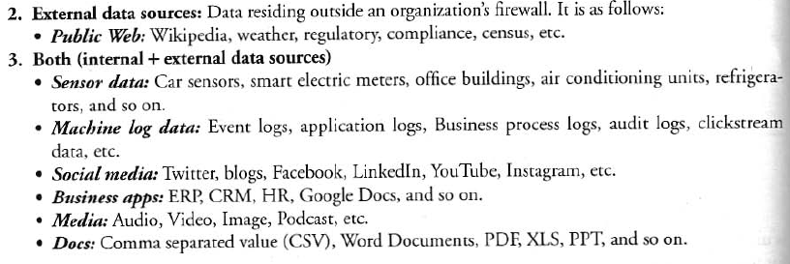

Slide 64
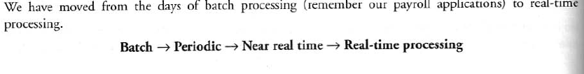
Velocity

Slide 65
Variety

Slide 66
Characteristics of Big Data
Back in 2001, Gartner analyst Doug Laney listed the 3 ‘V’s of Big Data –
Variety
Velocity
Volume

Slide 67
What is 5 V's of big data?
Big data is a collection of data from many different sources and is often describe by five characteristics:
Variety
Velocity
Volume
Veracity
value

Slide 68
Other Characteristics of Big Data
Veracity and Validity
Volatility
Variability

Slide 69
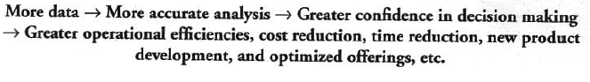
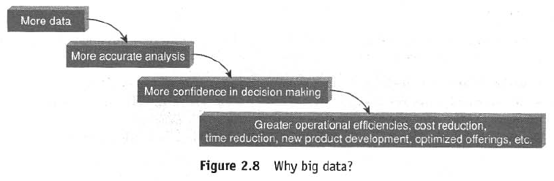
Why Big Data ?

Slide 70
Why Big Data Analytics
Big Data analytics is a process used to extract meaningful insights, such as hidden patterns, unknown correlations, market trends, and customer preferences.

Slide 71
Big Data Analytics Advantages
Cost Savings : help in identifying more efficient ways of doing business.
Time Reductions :helps businesses analyzing data immediately and make quick decisions based on the learnings.
New Product Development : By knowing the trends of customer needs and satisfaction through analytics you can create products according to the wants of customers.
Understand the market conditions : By analyzing big data you can get a better understanding of current market conditions.
Control online reputation: Big data tools can do sentiment analysis. Therefore, you can get feedback about who is saying what about your company.

Slide 72
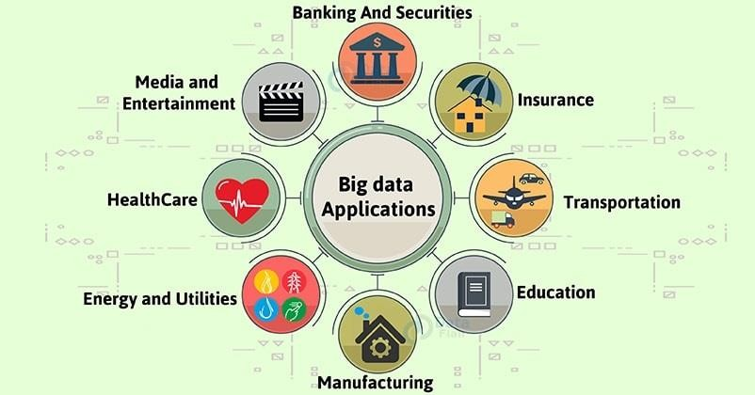
Big Data Analytics Applications

Slide 73
Ecommerce - Predicting customer trends and optimizing prices are few of the ways e-commerce uses Big Data analytics
Marketing - Big Data analytics helps to drive high ROI marketing campaigns, which result in improved sales
Education - Used to develop new and improve existing courses based on market requirements
Healthcare - With the help of a patient’s medical history, Big Data analytics is used to predict how likely they are to have health issues
Media and entertainment - Used to understand the demand of shows, movies, songs, and more to deliver a personalized recommendation list to its users

Slide 74
Banking - Customer income and spending patterns help to predict the likelihood of choosing various banking offers, like loans and credit cards
Telecommunications - Used to forecast network capacity and improve customer experience
Government - Big Data analytics helps governments in law enforcement, among other things

Slide 75
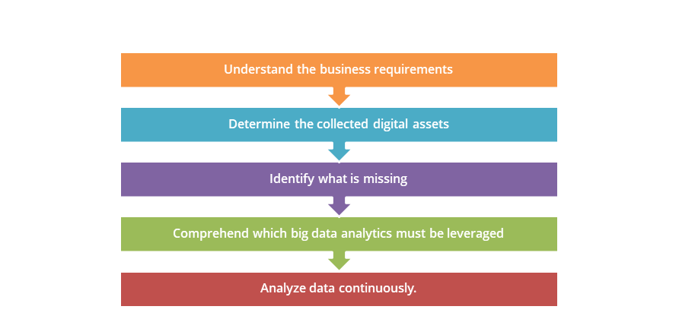
Best Practices for Big data Analytics

Slide 76
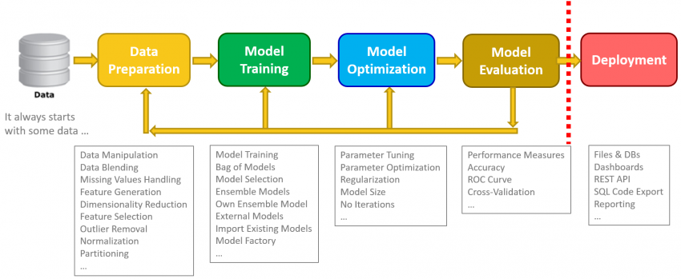
Best practices for Big Data Analytics

Slide 77
Analyzing the Data with Unix Tools
The classic tool for processing line-oriented data is awk.
Awk is a scripting language used for manipulating data and generating reports. The awk command programming language requires no compiling and allows the user to use variables, numeric functions, string functions, and logical operators.
Awk is a utility that enables a programmer to write tiny but effective programs in the form of statements that define text patterns that are to be searched for in each line of a document and the action that is to be taken when a match is found within a line.
Awk is mostly used for pattern scanning and processing. It searches one or more files to see if they contain lines that matches with the specified patterns and then perform the associated actions.
Awk is abbreviated from the names of the developers – Aho, Weinberger, and Kernighan.

Slide 78
Analyzing the Data with Unix Tools
What’s the highest recorded global temperature for each year in the dataset? We will answer this first without using Hadoop, as this information will provide a performance baseline and a useful means to check our results.
Example :A program for finding the maximum recorded temperature by year from NCDC weather records (small script to calculate the maximum temperature for each year.)
#!/usr/bin/env bash
for year in all/*
do
echo -ne `basename $year .gz`"\t"
gunzip -c $year | \
awk '{ temp = substr($0, 88, 5) + 0;
q = substr($0, 93, 1);
if (temp !=9999 && q ~ /[01459]/ && temp > max) max = temp }
END { print max }'
done

Slide 79
Analyzing the Data with Hadoop
To take advantage of the parallel processing that Hadoop provides, we need to express our query as a MapReduce job.
Map and Reduce
MapReduce works by breaking the processing into two phases: the map phase and the reduce phase.
Each phase has key-value pairs as input and output, the types of which may be chosen by the programmer.
The programmer also specifies two functions: the map function and the reduce function.

Slide 80
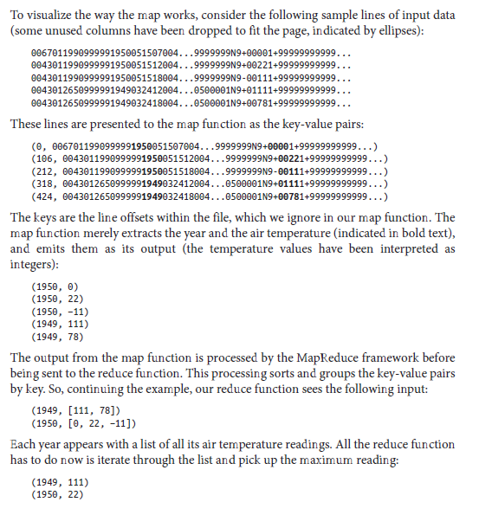

Slide 81
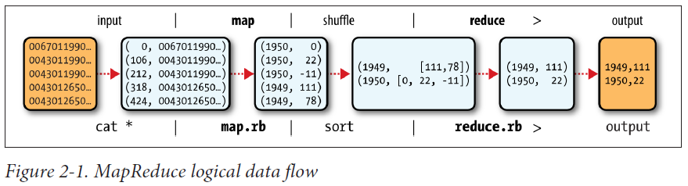

Slide 82
Java MapReduce
Example 2-3. Mapper for the maximum temperature example
import java.io.IOException;
import org.apache.hadoop.io.IntWritable;
import org.apache.hadoop.io.LongWritable;
import org.apache.hadoop.io.Text;
import org.apache.hadoop.mapreduce.Mapper;
public class MaxTemperatureMapper
extends Mapper<LongWritable, Text, Text, IntWritable> {
private static final int MISSING = 9999;
@Override
public void map(LongWritable key, Text value, Context context)
throws IOException, InterruptedException {
String line = value.toString();
String year = line.substring(15, 19);
int airTemperature;
if (line.charAt(87) == '+') { // parseInt doesn't like leading plus signs
airTemperature = Integer.parseInt(line.substring(88, 92));
} else {
airTemperature = Integer.parseInt(line.substring(87, 92));
}
String quality = line.substring(92, 93);
if (airTemperature != MISSING && quality.matches("[01459]")) {
context.write(new Text(year), new IntWritable(airTemperature));
}
}
}

Slide 83
The reduce function is similarly defined using a Reducer, as illustrated in Example 2-4.
Example 2-4. Reducer for the maximum temperature example
import java.io.IOException;
import org.apache.hadoop.io.IntWritable;
import org.apache.hadoop.io.Text;
import org.apache.hadoop.mapreduce.Reducer;
public class MaxTemperatureReducer
extends Reducer<Text, IntWritable, Text, IntWritable> {
@Override
public void reduce(Text key, Iterable<IntWritable> values, Context context)
throws IOException, InterruptedException {
int maxValue = Integer.MIN_VALUE;
for (IntWritable value : values) {
maxValue = Math.max(maxValue, value.get());
}
context.write(key, new IntWritable(maxValue));
}
}

Slide 84
The third piece of code runs the MapReduce job (see Example 2-5).
Example 2-5. Application to find the maximum temperature in the weather dataset
import org.apache.hadoop.fs.Path;
import org.apache.hadoop.io.IntWritable;
import org.apache.hadoop.io.Text;
import org.apache.hadoop.mapreduce.Job;
import org.apache.hadoop.mapreduce.lib.input.FileInputFormat;
import org.apache.hadoop.mapreduce.lib.output.FileOutputFormat;
public class MaxTemperature {
public static void main(String[] args) throws Exception {
if (args.length != 2) {
System.err.println("Usage: MaxTemperature <input path> <output path>");
System.exit(-1);
}
Job job = new Job();
job.setJarByClass(MaxTemperature.class);
job.setJobName("Max temperature");
FileInputFormat.addInputPath(job, new Path(args[0]));
FileOutputFormat.setOutputPath(job, new Path(args[1]));
job.setMapperClass(MaxTemperatureMapper.class);
job.setReducerClass(MaxTemperatureReducer.class);
job.setOutputKeyClass(Text.class);
job.setOutputValueClass(IntWritable.class);
System.exit(job.waitForCompletion(true) ? 0 : 1);
}
}

Slide 85
Hadoop Streaming
Hadoop provides an API to MapReduce that allows you to write your map and reduce functions in languages other than Java.
Hadoop Streaming uses Unix standard streams as the interface between Hadoop and your program, so you can use any language that can read standard input and write to standard output to write your MapReduce program.
Streaming is naturally suited for text processing. Map input data is passed over standard input to your map function, which processes it line by line and writes lines to standard output.
A map output key-value pair is written as a single tab-delimited line.
Input to the reduce function is in the same format—a tab-separated key-value pair—passed over standard input. The reduce function reads lines from standard input, which the framework guarantees are sorted by key, and writes its results to standard output.

Slide 86
Ruby
The map function can be expressed in Ruby as shown in Example 2-7.
Example 2-7. Map function for maximum temperature in Ruby
#!/usr/bin/env ruby
STDIN.each_line do |line|
val = line
year, temp, q = val[15,4], val[87,5], val[92,1]
puts "#{year}\t#{temp}" if (temp != "+9999" && q =~ /[01459]/)
end

Slide 87
The reduce function shown in Example 2-8 is a little more complex.
Example 2-8. Reduce function for maximum temperature in Ruby
#!/usr/bin/env ruby
last_key, max_val = nil, -1000000
STDIN.each_line do |line|
key, val = line.split("\t")
if last_key && last_key != key
puts "#{last_key}\t#{max_val}"
last_key, max_val = key, val.to_i
else
last_key, max_val = key, [max_val, val.to_i].max
end
end
puts "#{last_key}\t#{max_val}" if last_key

Slide 88
Python
Streaming supports any programming language that can read from standard input and write to standard output, so for readers more familiar with Python, here’s the same example again.
The map script is in Example 2-9, and the reduce script is in Example 2-10.
Example 2-9. Map function for maximum temperature in Python
#!/usr/bin/env python
import re
import sys
for line in sys.stdin:
val = line.strip()
(year, temp, q) = (val[15:19], val[87:92], val[92:93])
if (temp != "+9999" and re.match("[01459]", q)):
print "%s\t%s" % (year, temp)

Slide 89
Example 2-10. Reduce function for maximum temperature in Python
#!/usr/bin/env python
import sys
(last_key, max_val) = (None, -sys.maxint)
for line in sys.stdin:
(key, val) = line.strip().split("\t")
if last_key and last_key != key:
print "%s\t%s" % (last_key, max_val)
(last_key, max_val) = (key, int(val))
else:
(last_key, max_val) = (key, max(max_val, int(val)))
if last_key:
print "%s\t%s" % (last_key, max_val)

Slide 90
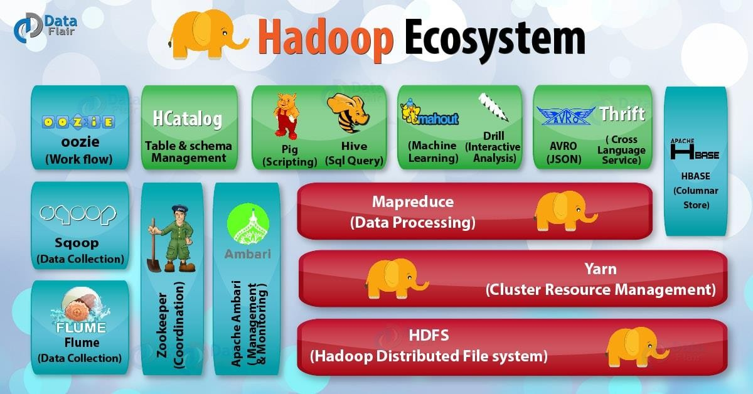

Slide 91
Hadoop
✴ Hadoop is an Apache open source framework written in java that allows distributed processing of large datasets across clusters of computers using simple programming models.
A Hadoop frame-worked application works in an environment that provides distributed storage and computation across clusters of computers.
✴ Hadoop is designed to scale up from single server to thousands of machines, each offering local computation and storage.

Slide 92
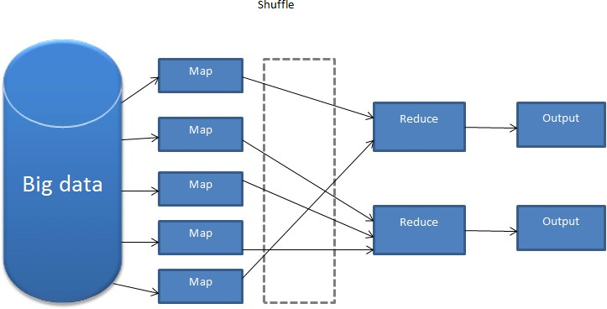
MapReduce
Hadoop MapReduce is a software framework for easily writing applications which process big amounts of data in-parallel on large clusters (thousands of nodes) of commodity hardware in a reliable, fault-tolerant manner.
The Map Task: This is the first task, which takes input data and converts it into a set of data, where individual elements are broken down into tuples (key/value pairs).
The Reduce Task: This task takes the output from a map task as input and combines those data tuples into a smaller set of tuples. The reduce task is always performed after the map task.
Typically both the input and the output are stored in a file-system. The framework takes care of scheduling tasks, monitoring them and re-executes the failed tasks.

Slide 93


Slide 94

Hadoop Distributed File System (HDFS)
Takes care of storage part of Hadoop architecture.
Hadoop HDFS broke the files into small pieces of data known as blocks. The default block size in HDFS is 128 MB.
We can configure the size of the block as per the requirements.
These blocks are stored in the cluster in a distributed manner on different nodes.
This provides a mechanism for MapReduce to process the data in parallel in the cluster.

Slide 95

Advantages of HDFS
Fault Tolerance–Each data blocks are replicated thrice ((everything is stored on three machines/Data Nodes by default) in the cluster. This helps to protect the data against data Node (machine) failure.
Space – Just add more data nodes if you need more disk space.
Scalability – Unlike traditional databases HDFS is highly scalable because it can store and distribute very large datasets across many nodes that can operate in parallel.
Flexibility –It can store any kind of data, whether its structured, semi-structured or unstructured.
Cost-effective – HDFS has direct attached storage and shares the cost of the network
and computers it runs on with the MapReduce. It's also an open source software.

